Slide 1





JWST Operations Jeff Valenti JWST Mission Scientist Space Telescope Science Institute

Slide 2
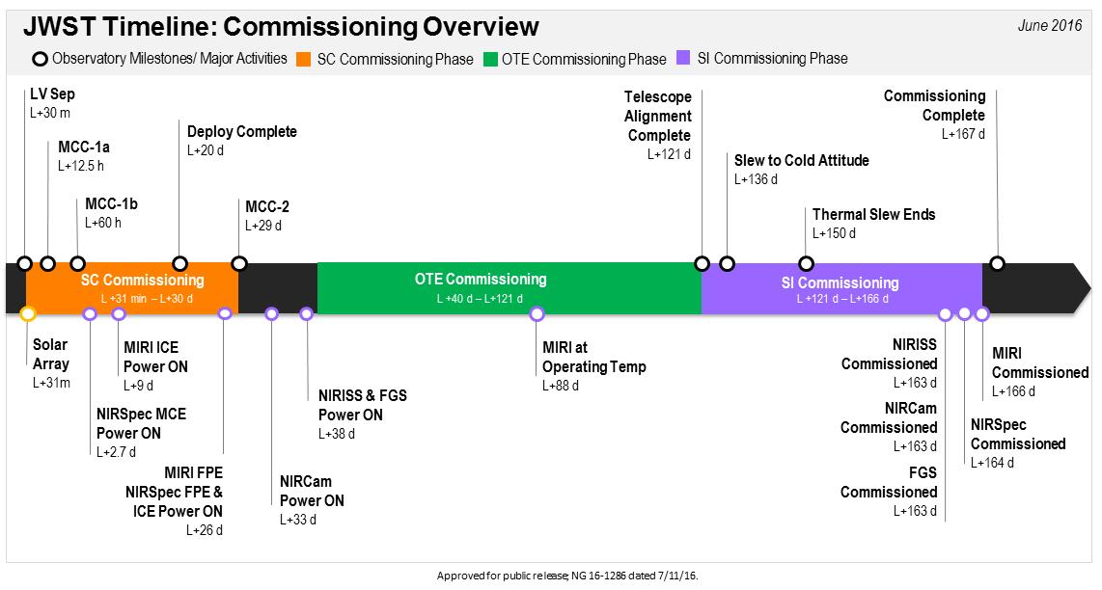
Commissioning is 6 very busy months

Slide 3
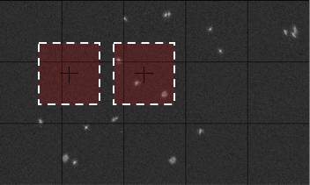
Simulated initial mosaic
NRC A

Slide 4
Telescope commissioning activities
Locate and identify segments
Control wavefront for individual segments
Make hexagonal pattern, retrieve phase, stack images
Co-phase the ensemble of segments
Coarse phasing with DHS, fine phasing with weak lenses
Sense multi-instrument multi-field (MIMF)
Correct errors not detectable at one field point
Assess stability with worst case thermal slew
Monitor and maintain wavefront
Sense every 2 days, correct 2 weeks, 1-2%
Perrin et al. 2016
SPIE 99040F

Slide 5
Telescope commissioning
Focus sweep
Segment ID
Image array
Global alignment
Image stacking
Coarse phasing
Coarse MIMF
Fine phasing
MIMF
Maintenance

Slide 6
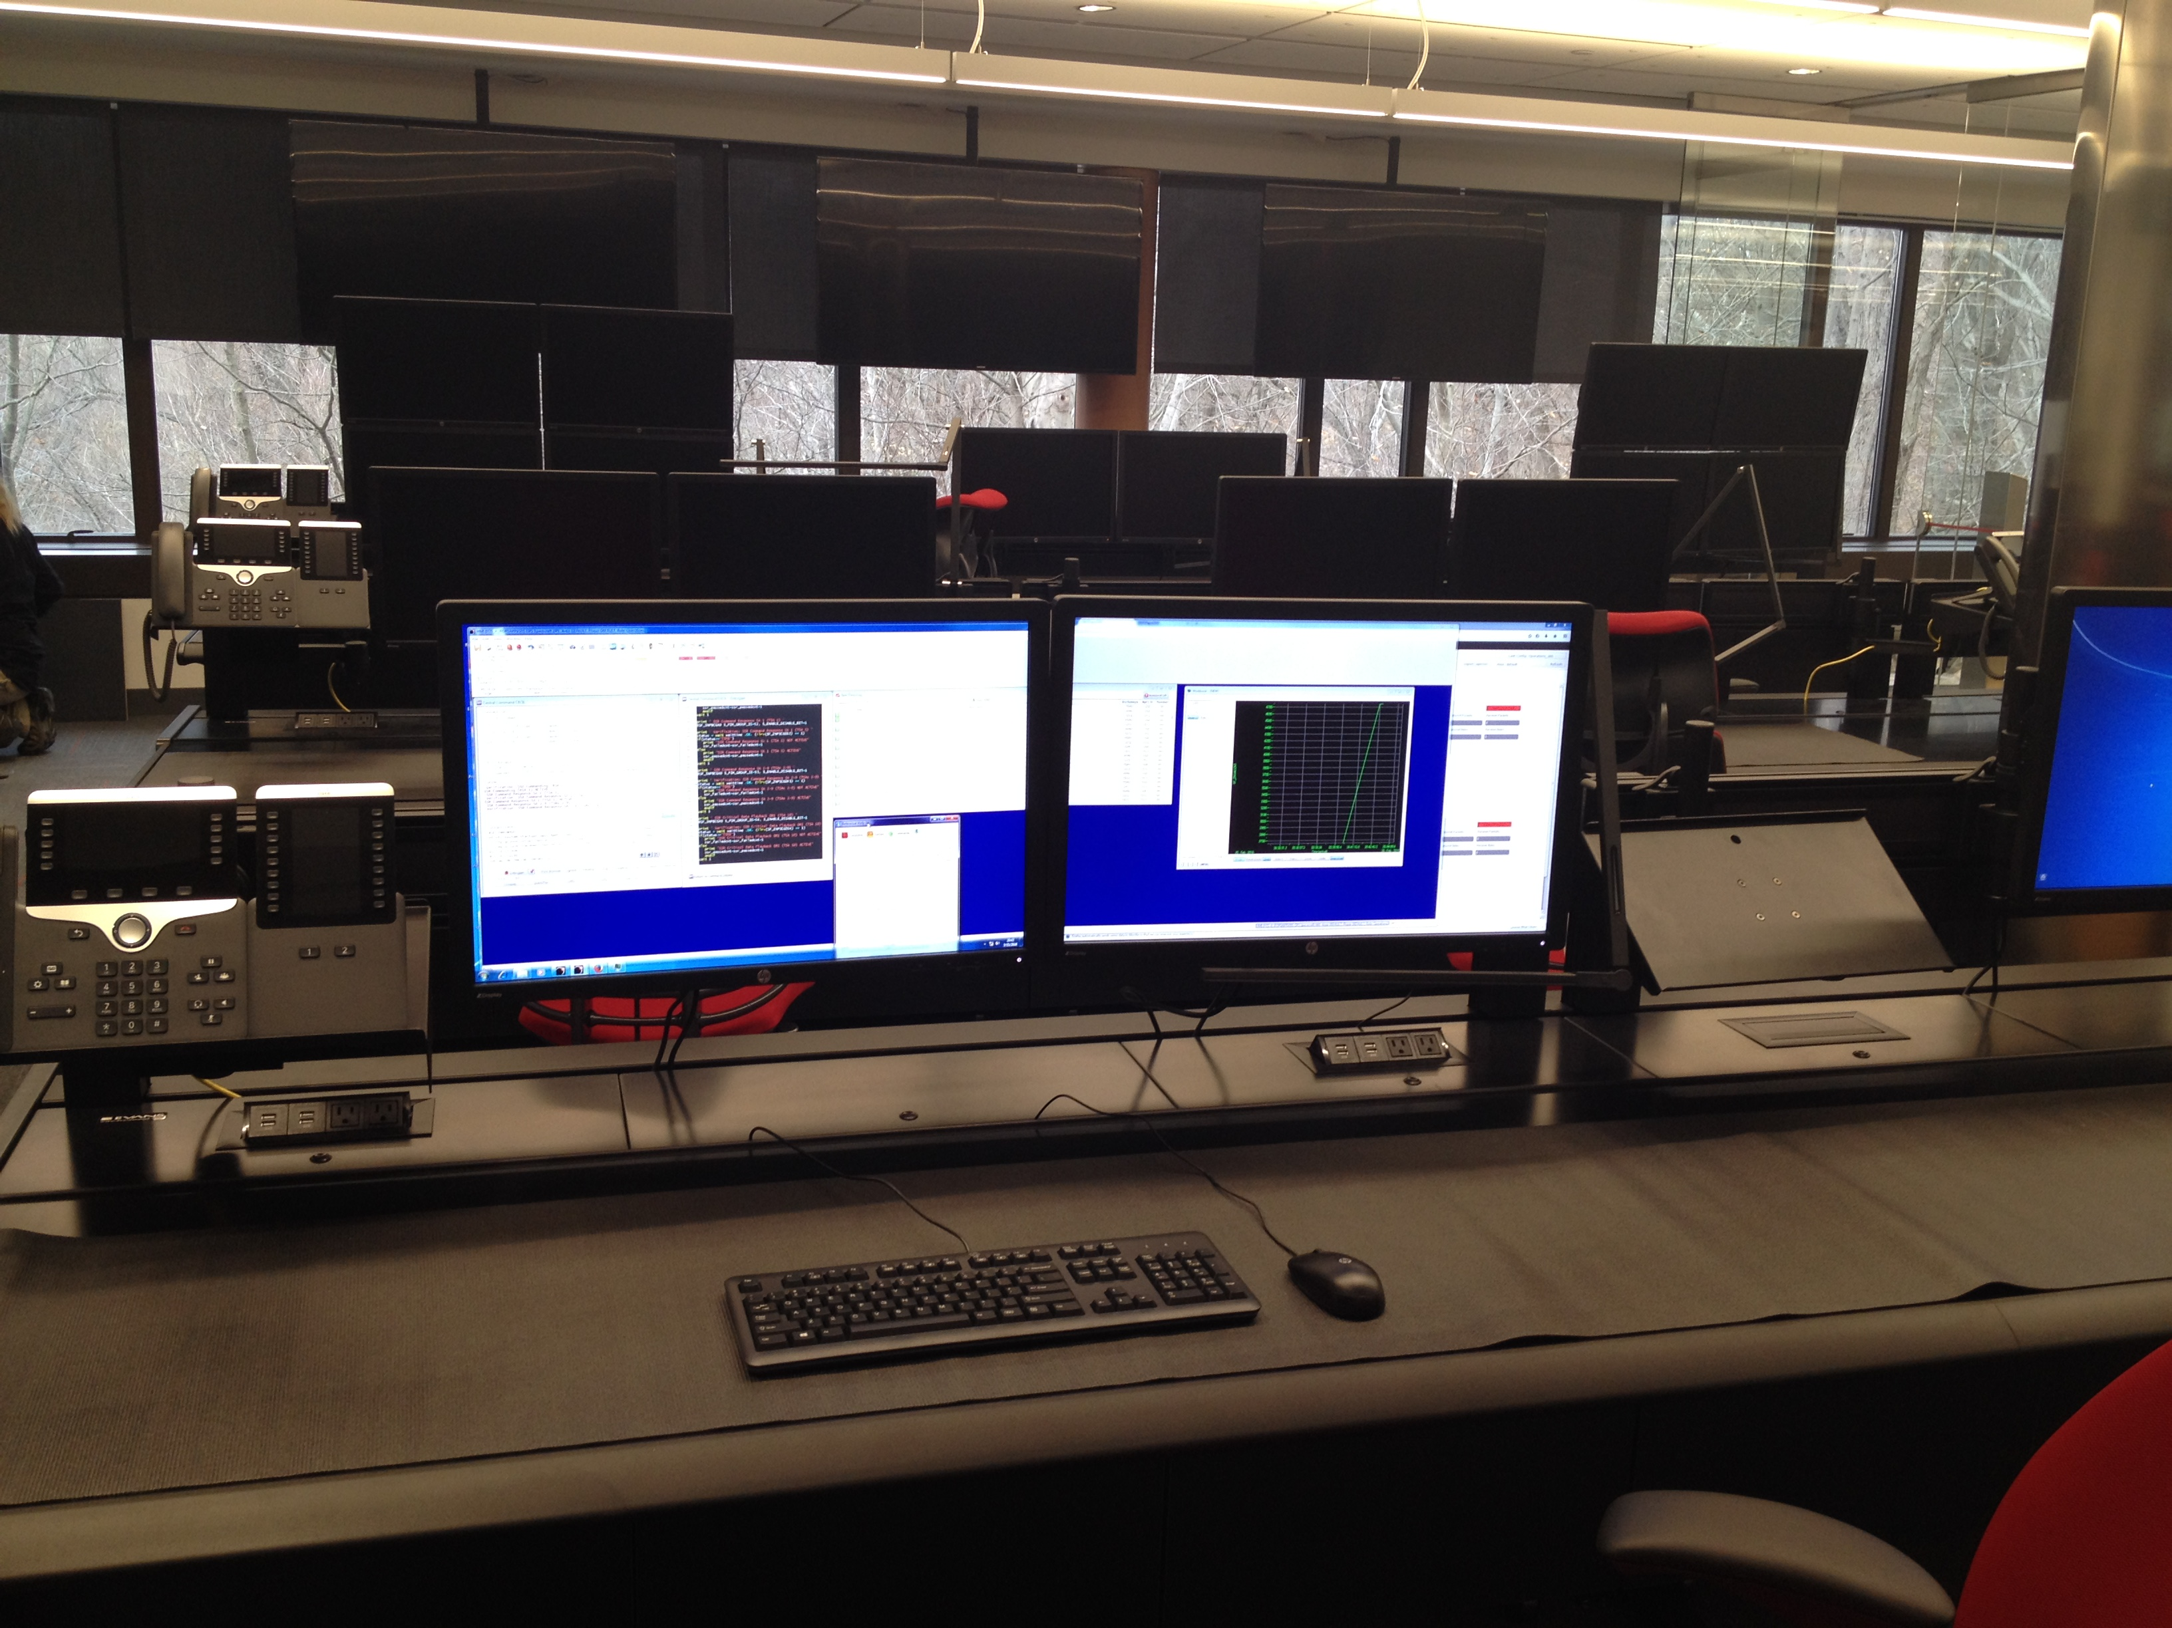
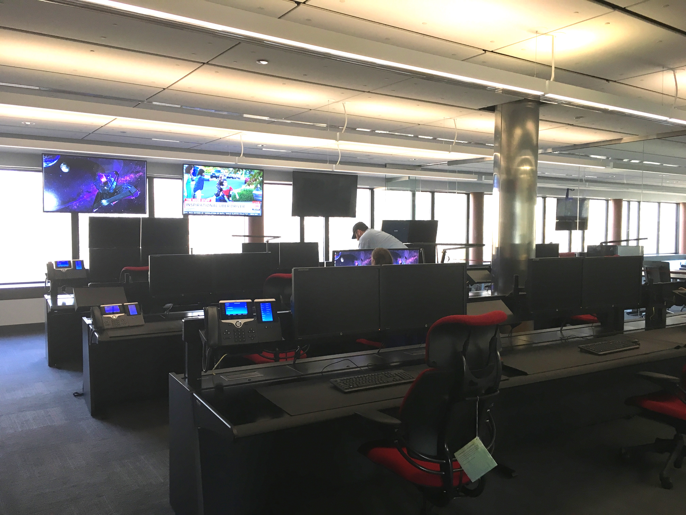
Mission operations center at STScI
JWST flight operations will be at STScI (unlike HST)
Facilitates integration of science and operations
First contact with deep space network recently

Slide 7
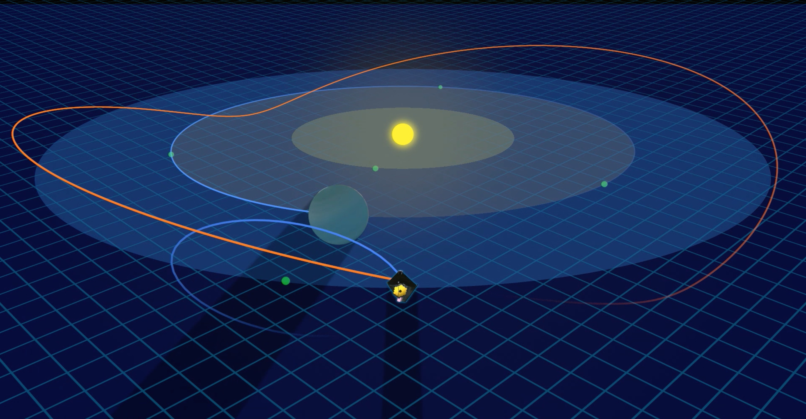
Quasi-periodic orbit around L2
JWST
L2
Notes:
Benefits of orbit: [1] relatively little propellant required to maintain orbit, [2] never in shadow of Earth (solar panels illuminated).
Propellant is the only consumable, sized for at least 10 years.
From Wikipedia: Although the L1, L2, and L3 points are nominally unstable, it turns out that it is possible to find (unstable) periodic orbits around these points, at least in the restricted three-body problem. These periodic orbits, referred to as "halo" orbits, do not exist in a full n-body dynamical system such as the Solar System. However, quasi-periodic (i.e. bounded but not precisely repeating) orbits following Lissajous-curve trajectories do exist in the n-body system. These quasi-periodic Lissajous orbits are what most of Lagrangian-point missions to date have used. Although they are not perfectly stable, a relatively modest effort at station keeping can allow a spacecraft to stay in a desired Lissajous orbit for an extended period of time. It also turns out that, at least in the case of Sun–Earth-L1 missions, it is actually preferable to place the spacecraft in a large-amplitude (100,000–200,000 km or 62,000–124,000 mi) Lissajous orbit, instead of having it sit at the Lagrangian point, because this keeps the spacecraft off the direct line between Sun and Earth, thereby reducing the impact of solar interference on Earth–spacecraft communications. Similarly, a large-amplitude Lissajous orbit around L2 can keep a probe out of Earth's shadow and therefore ensures a better illumination of its solar panels.

Slide 8
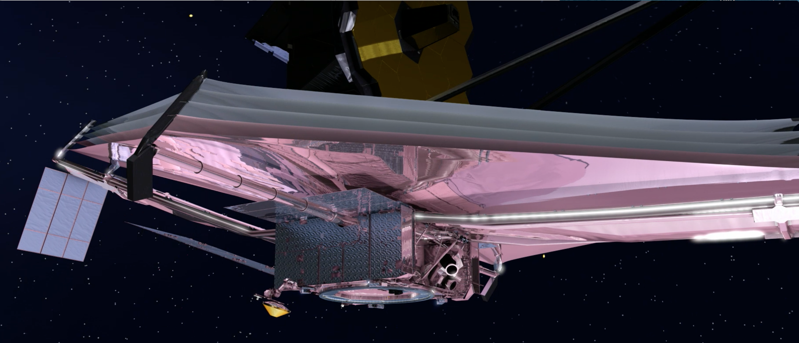
Spacecraft on hot side of sunshield
Balance
torque
High gain
antenna
Star
trackers
Notes:
High gain antenna is steerable, no need to interrupt observations to downlink data, though there may be pointing transients when antenna moves.
Fine Guidance Sense keeps guide star at precise location in the focal plane. 7 mas jitter, 1 axis
Attitude control system uses star trackers to measure observatory roll angle. Roll jitter moves target tangent to radius from guide star.
Nominal downlink rate is 57 GB of science data per day, which is one 2048^2 image every 13 seconds.
JWST reads out a 2048^2 detector in 11 seconds using 4 amps. JWST has 17 detectors.
Some dead time for detector reset, slews, instrument configuration, etc.
However, frames will generally need to be coadded on board.
Subarrays typically use only 1 amp, so coaddition is not necessary.

Slide 9
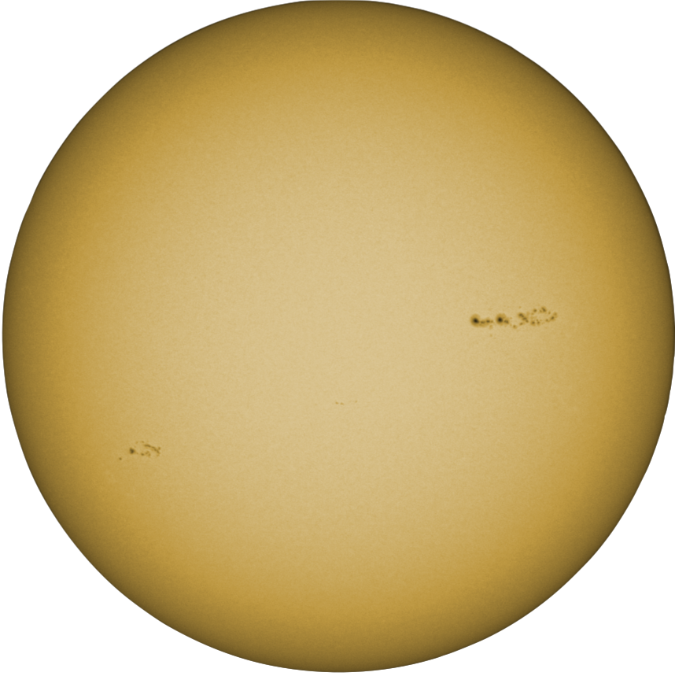
Pointing and roll limits
Ecliptic
Pole
Roll limit is
±5 degrees
Continuous
Viewing
Zone
5˚
45˚
360˚
CVZ
Notes:
50 days windows twice a year in the ecliptic.

Slide 10
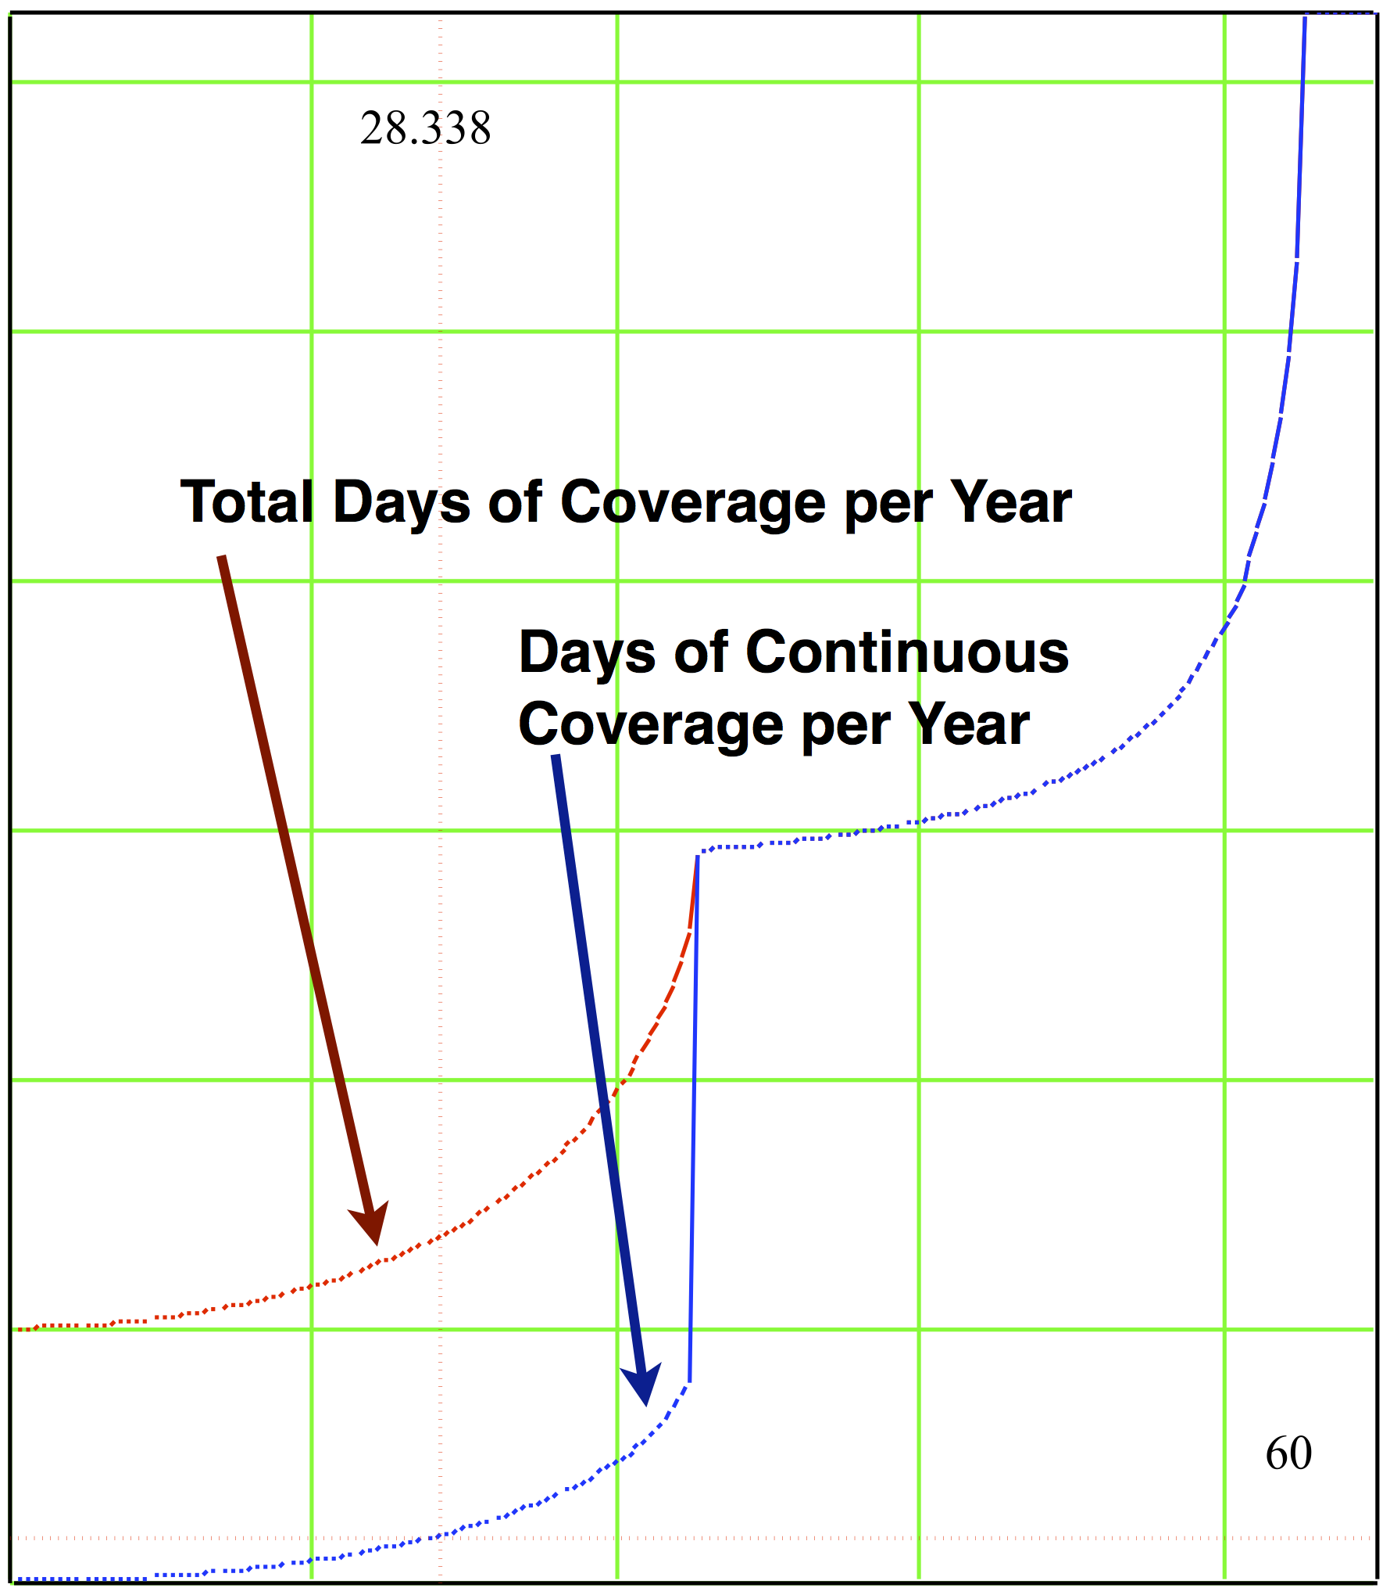
Days per years a target is observable
85
350
APT reports specific
visibility windows
300
Total
250
Contiguous
CVZ
200
Target Visibility (days/year)
150
100
50
0
20
40
60
80
| Ecliptic Latitude | (degrees)
Notes:
When is CVZ important? Commissioning, early release science, targets that require observations throughout the year.
For most planets, two 50 day windows per year is fine.
Fraction of sky: CVZ 9%, 1 window 62%, 2 windows 29%.

Slide 11
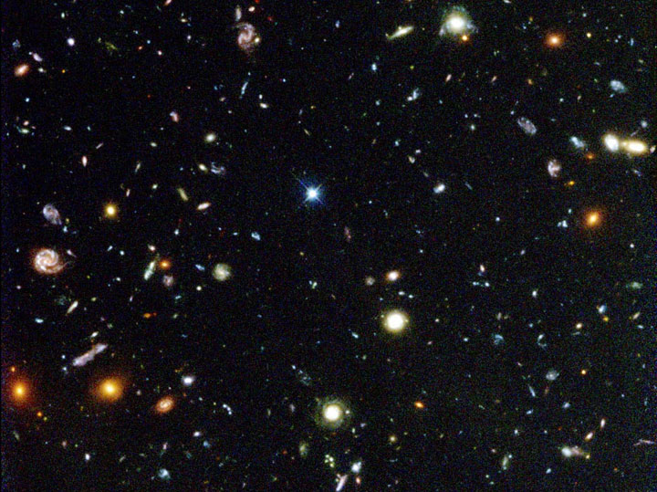
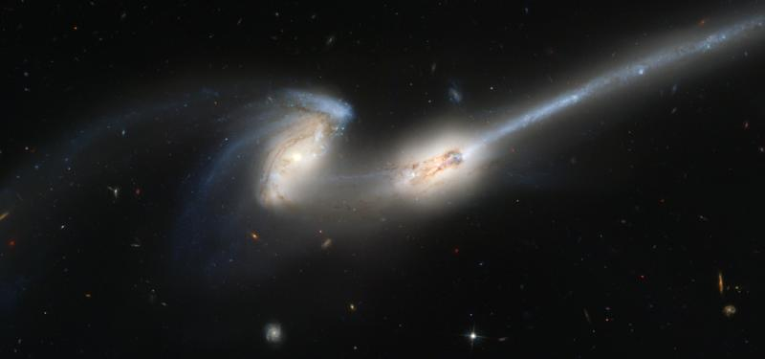
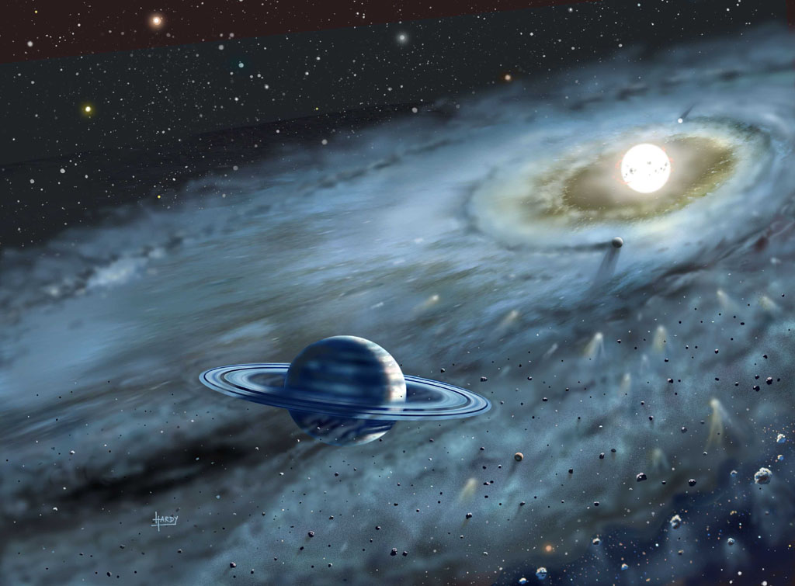
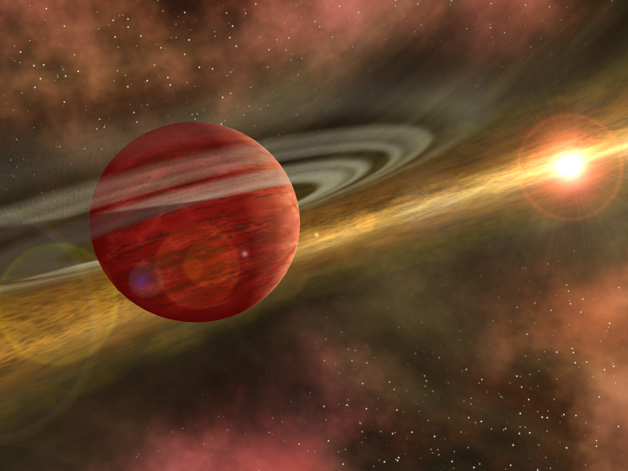
Four JWST science themes
End of the dark ages: First light and reionization
Assembly of galaxies
"Exploring the Universe with JWST"
Birth of stars and protoplanetary systems
Planetary systems and the origin of life

Slide 12
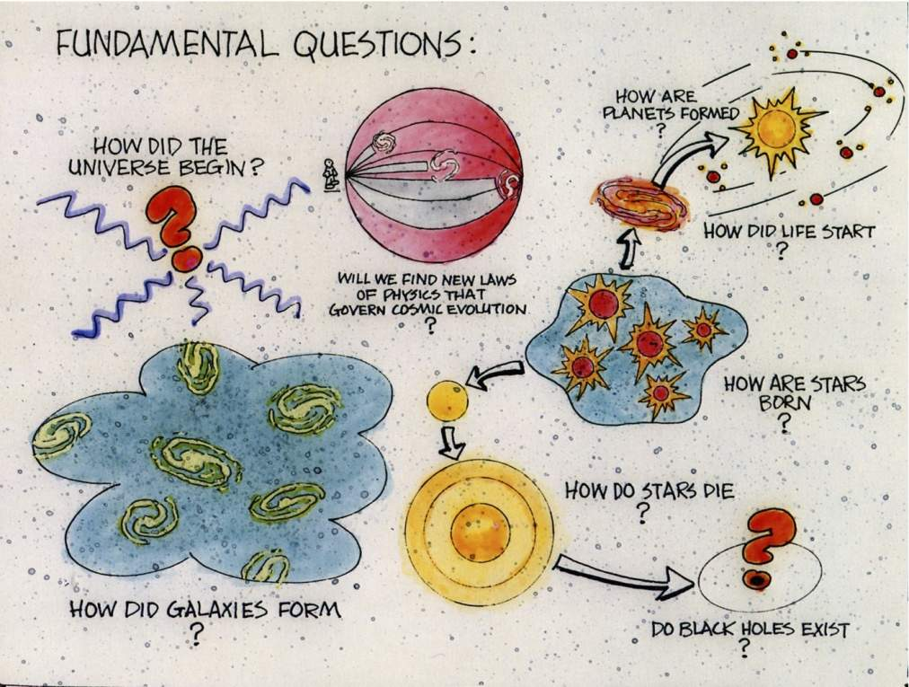
Great Observatories brochure (mid-1980’s) via John Mather

Slide 13
Life of a JWST program – Proposal
Think of a great experiment | Astronomer
Calculate exposure times | Pandeia
Specify observations | APT
Plan visits | APT
Justify science | Astronomer
Submit Proposal | APT
Evaluate submitted proposals | TAC
Allocate time | Director

Slide 14
Life of a JWST program – Execution
Check program specification | STScI staff
Build long-range plan | VPS
Build short-term schedules | VSS
Upload observation plan | FOS
Execute observation plan | OSS
Download data from JWST | FOS

Slide 15
Life of a JWST program – Data
Process science data | SDP
Calibrate science data | Pipeline
Ingest data products | Ingest
Discover data products | MAST Portal
Download data from archive | via URL
Recalibrate data | Pipeline
Analyze data | Tools
Publish results promptly | Astronomer

Slide 16
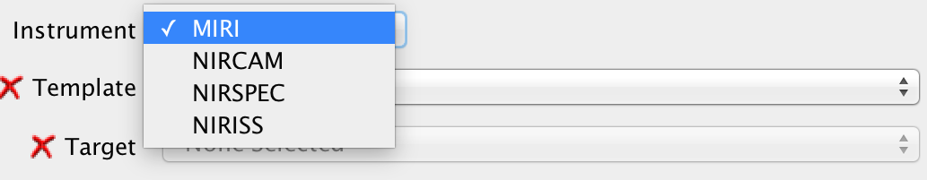
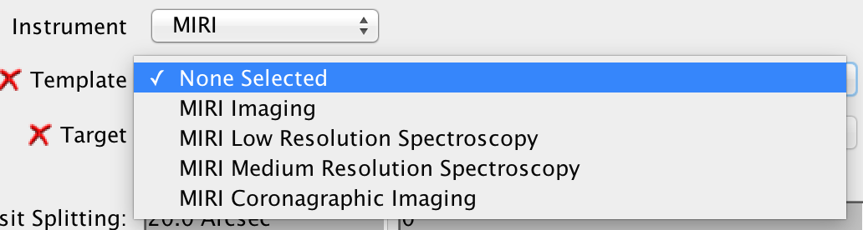
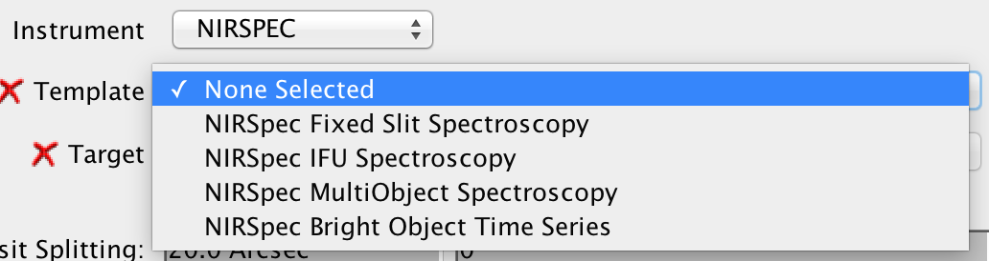
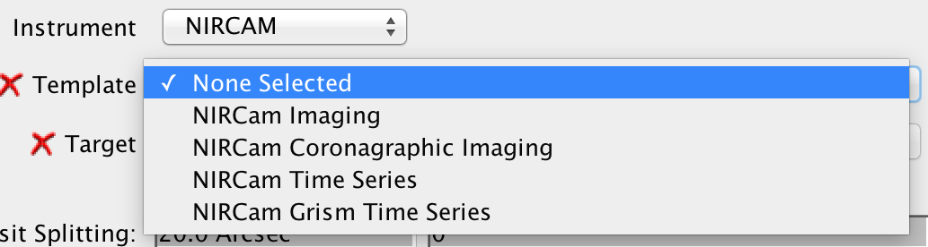
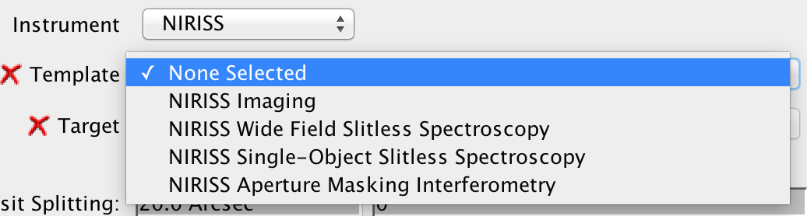
Science templates in APT
Templates simplify system design and program preparation.

Slide 17
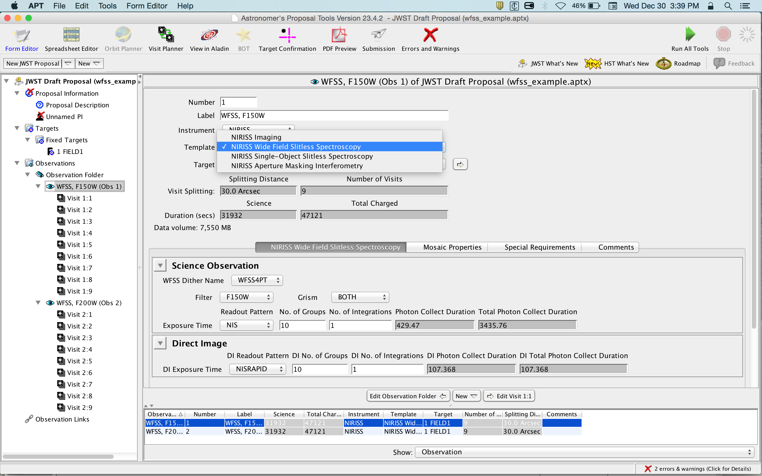

Slide 18
Program, observation, visit
A program consists of one or more observations.
An observation is an instance of an APT template.
APT splits each observation into one or more visits.
A science visit has one guide star acquisition.
The scheduling system creates a visit sequence.

Slide 19
Event driven operations
Operations uploads an ordered sequence of visits.
Each visit has a time window when it can start.
Within start window → Execute immediately
Before start window → Wait until window opens
After start window → Skip visit
Visit constraints reduce scheduling efficiency.
Field of regard only → 50-365 day window
Roll constraint → 10 days (less for multiple rolls)
Timing constraint → as tight as 5 minutes
Waiting for start window to open is an overhead.

Slide 20
Example of a failed guide star acquisition
Current S/C Time
Earliest
Start Time
Latest
Start Time
Visit End
Time
CHK
SLEW
GSACQ
AD
HOME
Earliest
Start Time
Latest
Start Time
Visit End
Time
CHK
SLEW
GSACQ
AD
AD
HOME
Earliest
Start Time
Latest
Start Time
CHK
SLEW
GSACQ
AD
AD
HOME

Slide 21
Summary
Commissioning will be a very busy 6 months.
Sunshield and orbit have operational impacts.
JWST will address a wide range of scientific topics.
Life of a program: proposal, execution, and data.
Observers specify an observation using a template.
Event-driven operations improve efficiency.

